Slide 1
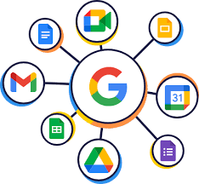




DATA MINING DSAI 4102
SUCCESS PREDICTION AND RECOMMENDATION SYSTEMS FOR GOOGLE APPS BASED ON RATING AND SENTIMENT DISCREPANCIES
Najla Zuhir
Parvathy Premkumar
Amna Mohammad Salim
SUPERVISOR: DR. MOSHIUR FARAZI
01

Slide 2

OUTLINE
Introduction
Dataset and Preprocessing
Exploratory Data Analysis (EDA)
Methodology
Results, Business Implications and Next Step
Conclusion
02

Slide 3

INTRODUCTION
03

Slide 4

THE PROBLEM
THE PROBLEM
Star ratings often don’t match the sentiment in reviews and is is inconsistent with the opinion expressed in the review.
THE REASON
Users may give a star rating based on their emotional state
Reviews often focus on specific app features while star ratings are meant to represent an overall impression, leading to mismatches.
Users may misinterpret the star rating scale, assigning a score that doesn't align with their written opinion
.
04

Slide 5
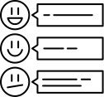
WHY IS THE PROBLEM CRUCIAL?
Misleading Ratings
Trust Issues
Fewer Downloads
Competition Problems
Additionally, even a few misaligned reviews can significantly lower the average rating, which is especially important for little apps with a few thousand downloads.
05

Slide 6
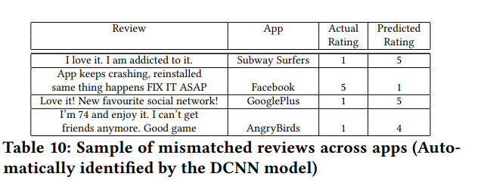
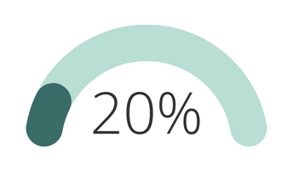

STUDY EXAMPLE
“Fault in Your Stars: An Analysis of Android App Reviews” by IBM Research
Reviews show discrepancies between ratings and sentiments.
AralikaE, R., IBM Research, Sridhara, G., IBM Research, Gantayat, N., IBM Research, Mani, S., & IBM Research. (2018). Fault in your stars: An Analysis of Android App Reviews [Journal-article].
06

Slide 7
PROJECT OBJECTIVE
Objectives:
Identify successful apps by Investigating rating-sentiment discrepancies.
Two Discrepancy-driven strategies:
App Success classification system
App Recommendation System
07

Slide 8
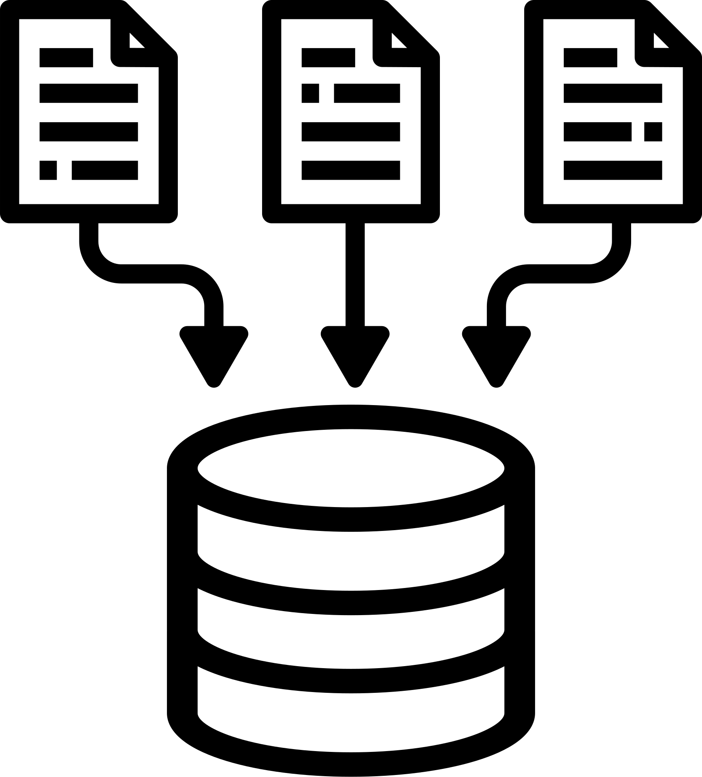
DATASET
AND PREPROCESSING
08

Slide 9
DATASET
Dataset Resources
Merging Dataset
Analysis & Insight
Pre-Processing
Unified Dataset
Google Play Dataset
10,000 applications
13 features
User Review Dataset
60,000 reviews (100 reviews per app)
5 features
Data Cleaning
Ensuring consistency in columns
Merge Process
Using “App” column as key
9800+ rows
Combined attributes
App Success
Recommendat-ions
09

Slide 10
DATA PREPROCESSSING
Missing values
Redundancies, and irrelevant attributes
Noise, such as special characters, was removed
Imbalance was handled using SMOTEENN
Numerical features like Size and Price were normalized
FEATURE ENGINEERING
SENTIMENT RATING
DISCREPANCY
USER ENGAGEMENT
SUCCESS CATEGORY
10

Slide 11
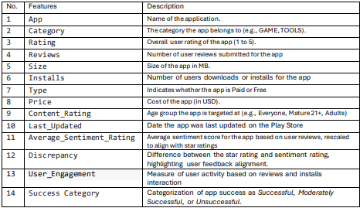
FINAL DATASET
11

Slide 12

EXPLORATORY DATA ANALYSIS (EDA)
12

Slide 13
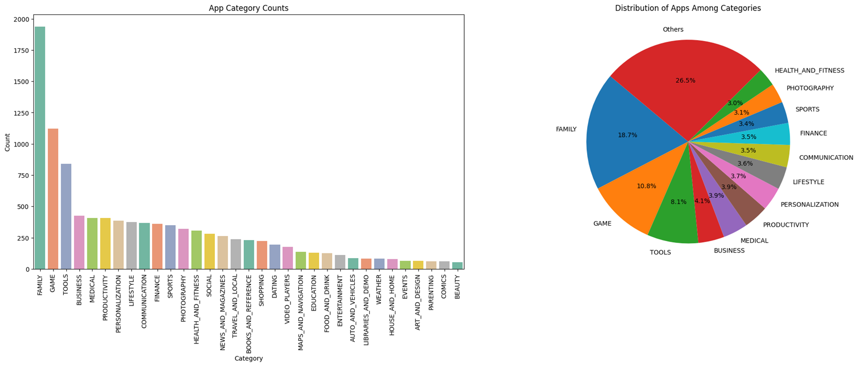
EXPLORATORY DATA ANALYSIS
Figure 1 : Distribution of apps across different categories on the Google Play Store.
13

Slide 14
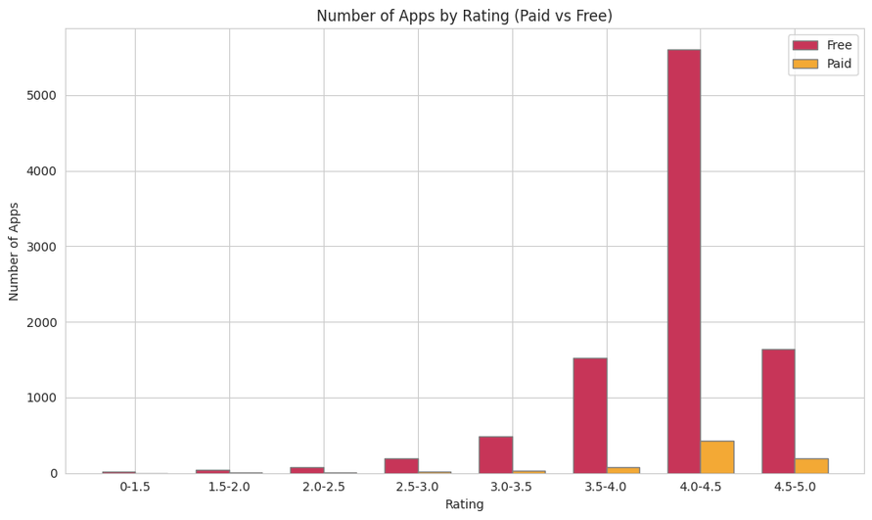
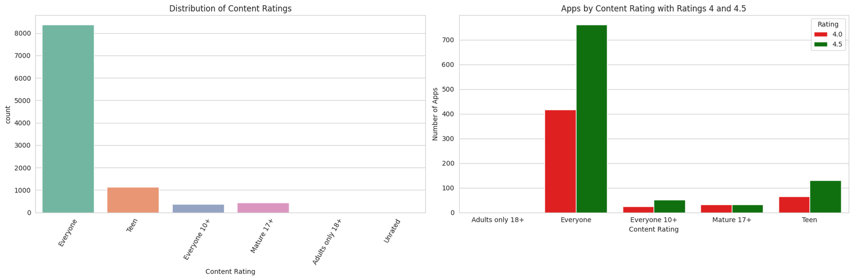
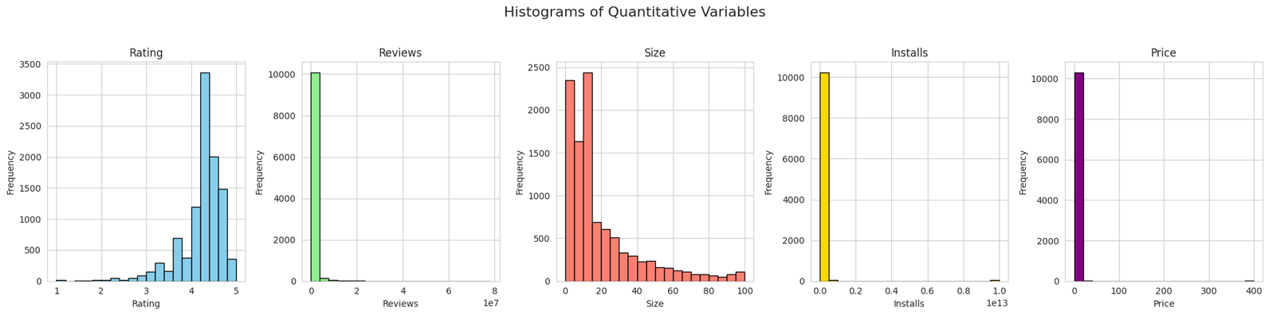
EXPLORATORY DATA ANALYSIS
Figure 2 : Type Vs Rating
Figure 3 : Distribution of Content Rating
Figure 4 : Distribution of Quantitative Features
14

Slide 15
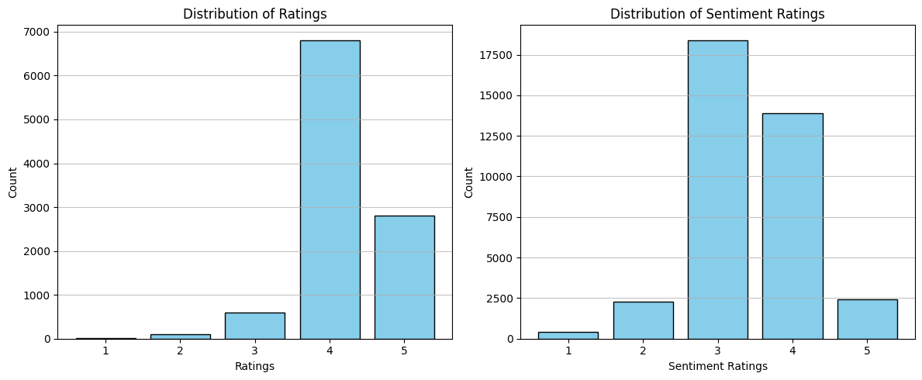
EXPLORATORY DATA ANALYSIS
Figure 5 : Numeric Ratings and Sentiment Ratings Discrepancy
15

Slide 16
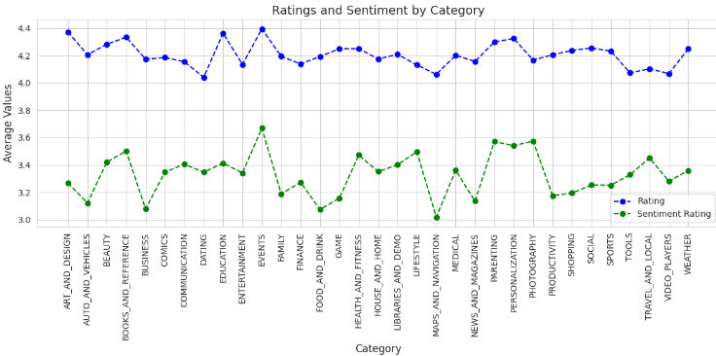
EXPLORATORY DATA ANALYSIS
Figure 6 : Average Ratings and Sentiment by Category
16

Slide 17

METHODOLOGY
AND
RESULTS
17

Slide 18
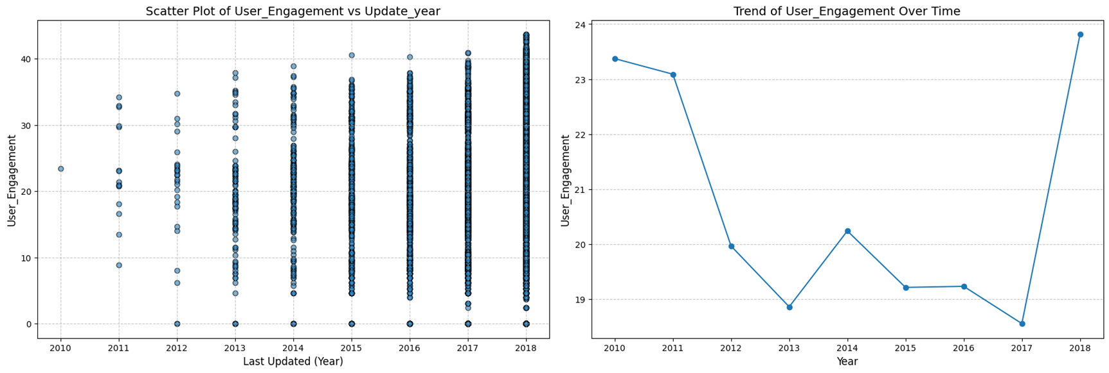
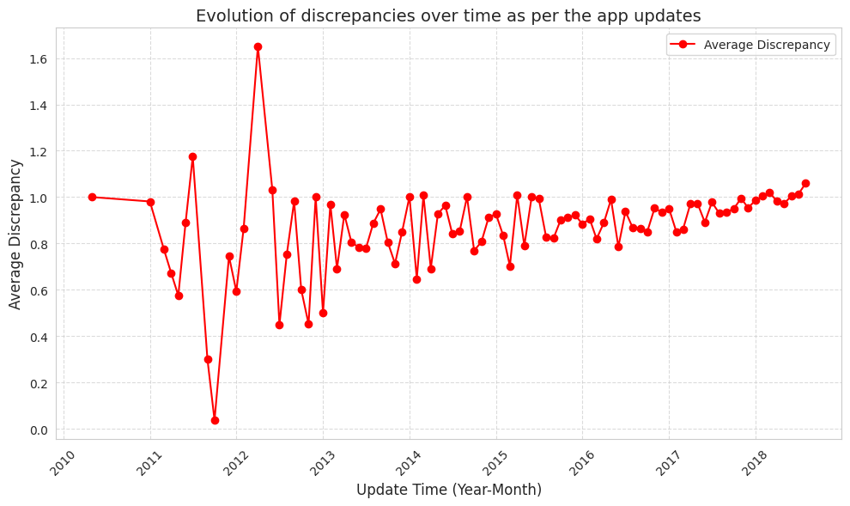
TARGET VARIABLE: SUCCESS CATEGORY
Key Features Utilized: User Engagement, Discrepancy, Last Updated
Key Insights:
Higher user engagement leads to better ratings and app quality.
Frequent updates reduce rating-sentiment gaps, improving app success.
[Ahsan Mahmood]. (2019). Identifying the influence of various factors of apps on Google Play apps ratings.
[Vijayanarayanan A]. (2023). Google Play Store Reviews Prediction Using ML and NLP.
18

Slide 19
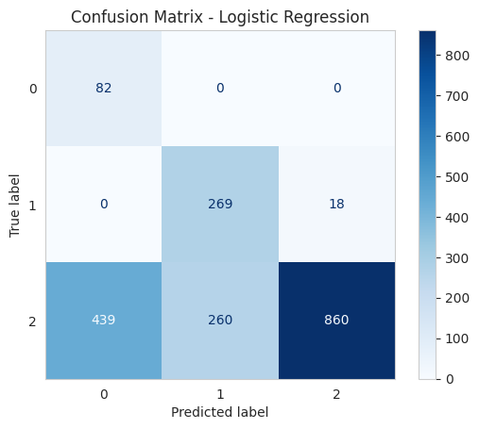
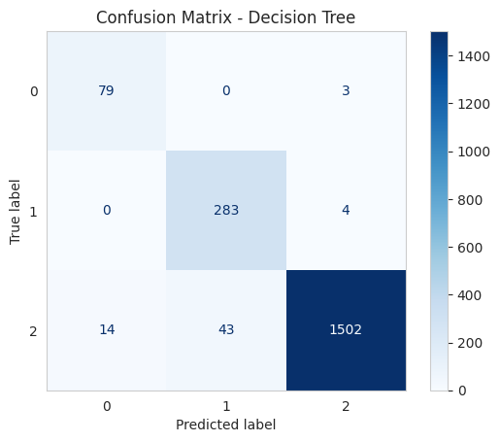

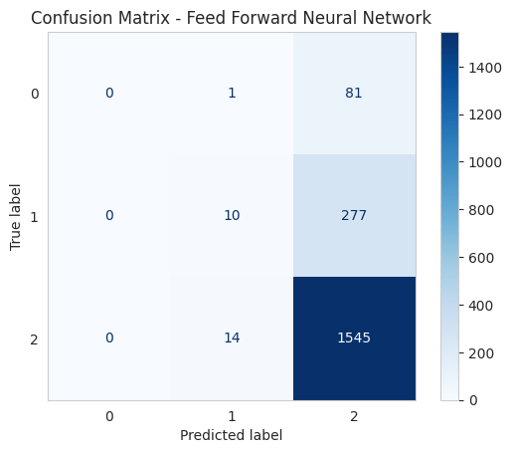
APP SUCCESS CLASSIFICATION
Baseline: Logistic Regression
Accuracy: 61.24
F1-Score: 66.95
Medium-Complexity: Decision Tree
Accuracy: 96.68
F1-Score: 96.76
Medium-Complexity: Random Forest
Accuracy: 95.64
F1-Score: 95.73
Highly Complex: FNN with hyper-parameters tuning
Accuracy: 80.6
F1-Score: 73.1
19

Slide 20
RECOMMENDATION SYSTEM - CONTENT BASED
Recommending top apps based on app category and discrepancy threshold
Input Category and Number of Recommendations (n_recommendations)
Calculate Mean Similarity Scores (Similarity Matrix -> Mean of Category App Indices)
Filter Apps Based on Input Category (new_df_copy[new_df_copy['Category'] == category])
Sort Scores in Descending Order and Select Top-n Indices
Is Filtered List Empty?
Retrieve Top-n Apps and Their Categories from DataFrame
NO
YES
Update Indexes to Start from 1
Map Category " Indices to Feature Matrix Indices
Output: "No apps found in the category"
Output Top-n Apps
20

Slide 21
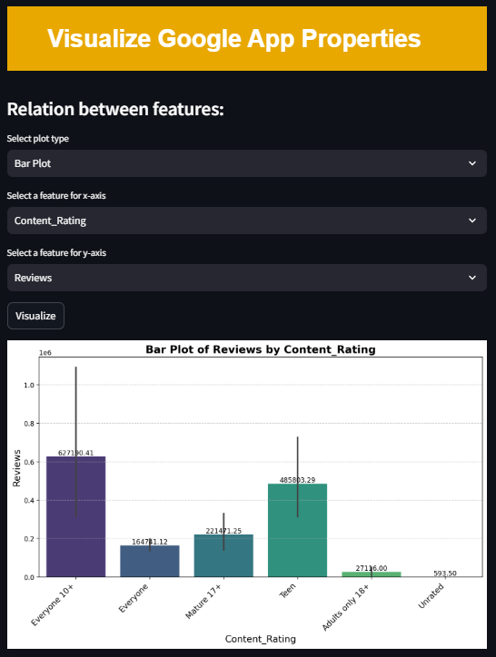

WEB INTERFACE FOR APP
21

Slide 22
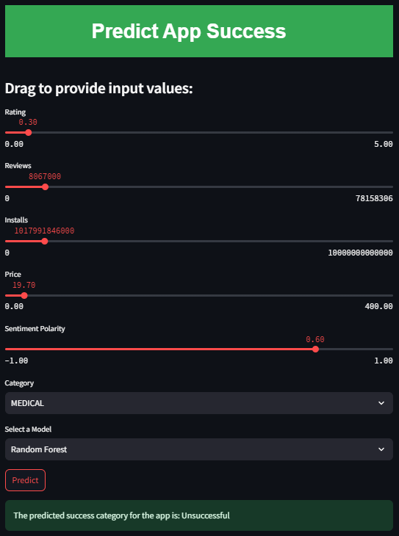
WEB INTERFACE FOR APP
21

Slide 23
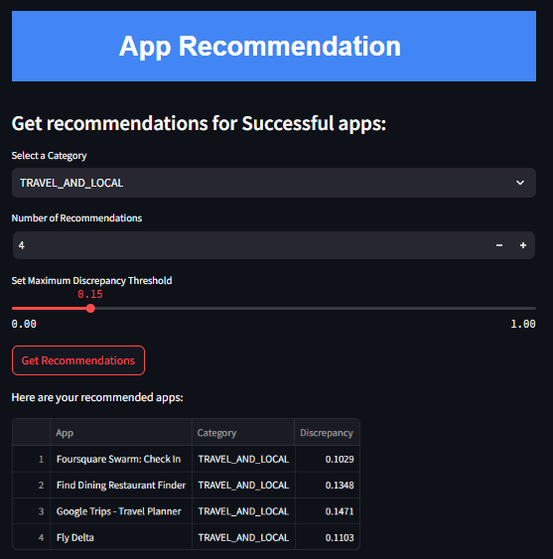
WEB INTERFACE FOR APP
21

Slide 24



KEY FINDINGS, BUSINESS IMPLICATIONS AND
NEXT STEP
22

Slide 25


FINDINGS
Model Performance
Best Success Prediction Model
Random Forest - accuracy (95.64%) and F1 score (95.73%)
Decision Tree - accuracy (96.68%)
The "Success Category" framework aligns user engagement with sentiment feedback for structured app evaluation.
Recommendation System
Sentiment-driven content-based filtering
Weighted features like Ratings, Sentiment Polarity, Discrepancy, and User Engagement
Better discovery of high-performing apps within user-defined categories
23

Slide 26

Business Implications:
Enhancing User Satisfaction
Strategic Decision-Making
Revenue Growth
Market Competitiveness
BUSINESS IMPLICATIONS & NEXT STEPS
Next Steps:
Enhancing Research Opportunities
Industry Application
Developer Tools and Innovations
24

Slide 27

CONCLUSION
Problem:
Challenges mobile app marketplace faces.
Misalignment in app recommendations reduces user satisfaction.
Solution:
Sentiment-driven machine learning models
Success Category framework for improved recommendation
Highlights:
Discrepancies: Identified how misalignment affects application success
Model Performance: Random Forest and Decision Tree outperformed others
Key Features: Recent updates strongly correlates to discrepancy, impacting app success
App success categorization: Successful, Moderately successful and Unsuccessful
25

Slide 28
REFERENCES
Intimal University. (2022). Journal of Data Science. Retrieved from http://eprints.intimal.edu.my/1575/1/jods2022_01.pdf
Parmar, A., Patel, D., Patel, N., & Bansal, A. (2019). Sentiment analysis on user reviews of Google Play Store apps. Smart Innovations in Communication and Computational Sciences, 15–25. https://doi.org/10.1007/s42488-019-00015-w
Google Play Store dataset. (n.d.). Retrieved from https://www.kaggle.com/lava18/google-play-store-apps
Singh, R., Sharma, S., & Kumar, D. (2023). Google Play Store reviews prediction using ML and NLP. Journal of Scientific Computing and Engineering Research, 6(4). Retrieved from https://jscer.org/wp-content/uploads/2023-Volume%206-Issue%204/Google%20playstore%20reviews%20prediction%20using%20ML%20and%20NLP%2021.pdf
Vaswani, A., Shazeer, N., Parmar, N., Uszkoreit, J., Jones, L., Gomez, A. N., ... & Polosukhin, I. (2017). Attention is all you need. arXiv preprint arXiv:1708.04968. Retrieved from https://arxiv.org/abs/1708.04968
Ruder, S., & Howard, J. (2020). Transfer learning for natural language processing. arXiv preprint arXiv:2006.09739. Retrieved from https://arxiv.org/abs/2006.09739v1
Mukherjee, D., et al. (2022). User behavior insights from app reviews: The case of Google Play Store. Financial Innovation Journal, 15(6). Retrieved from https://fbj.springeropen.com/articles/10.1186/s43093-022-00114-y
IEEE Explore. (2021). Machine learning trends in app reviews. Retrieved from https://ieeexplore.ieee.org/document/9515087
26

Slide 29
THANK YOU
27

